Slide 1


Black Scholes Equation
Abhishek Kumar

Slide 2
What is Black Scholes Equation/Model ?
The Black-Scholes model, is one of the most important concepts in modern financial theory.
This mathematical equation estimates the theoretical value of derivatives based on other investment instruments, taking into account the impact of time and other risk factors.
Developed in 1973, it is still regarded as one of the best ways for pricing an options contract.

Slide 3
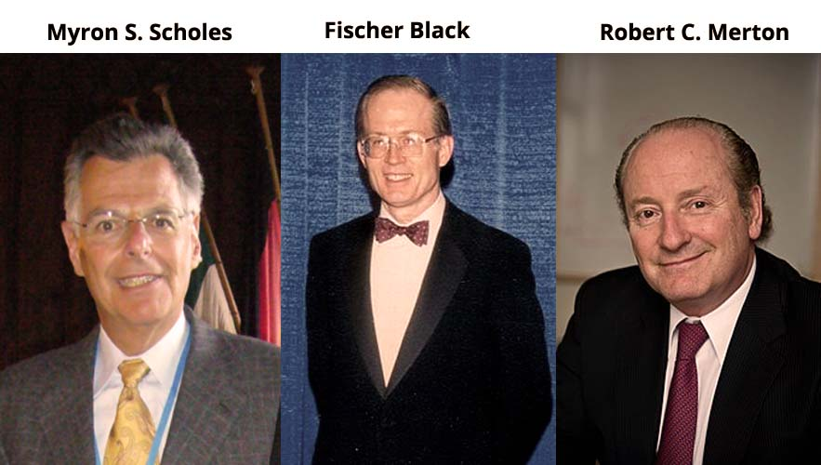
History of Black Scholes Equation/Model
This model was developed in 1973 by Fisher Black , Robert Merton , Myron Scholes were economists.
This also known as the Black-Scholes-Merton (BSM) model.
For this work they had won the Nobel prize in economics in 1997.

Slide 4
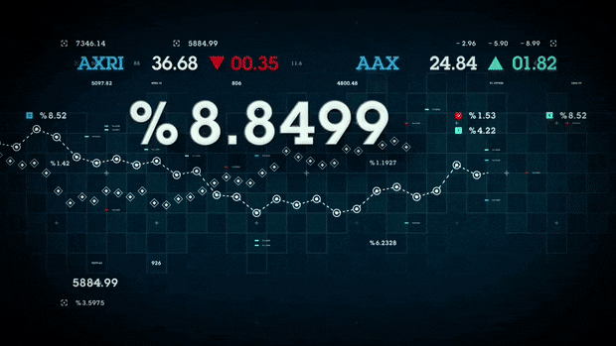
Why Black Scholes Equation is used ?
This model is used to find the current value of a call option whose ultimate value depends on the price of the stock at the expiration date. Because the stock price keeps changing, the value of this call option will change too.

Slide 5
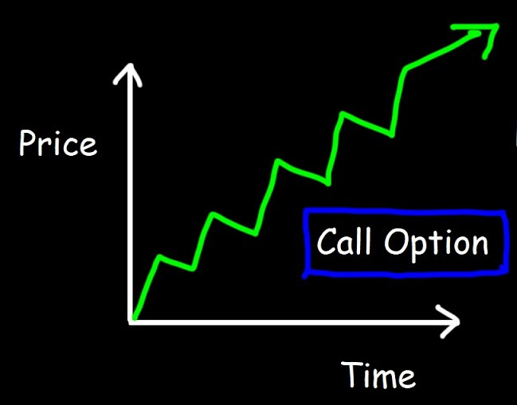
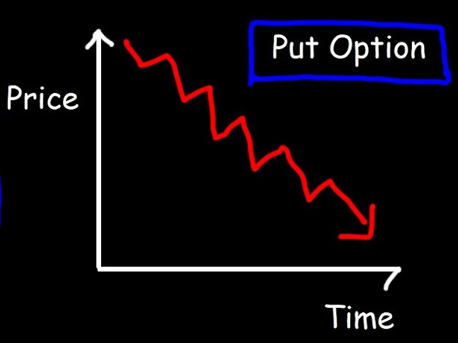
Financial terms we need to understand
Option : A security giving the right to buy or sell an asset , subject to certain conditions , within a specified period of time.
(a) Call option : An option which grants its holder the
right to buy the underlying asset at a strike at some moment
in the future.
(b) Put Option : An option which grants its holder the
right to sell the underlying asset at a strike at some
moment in the future.

Slide 6

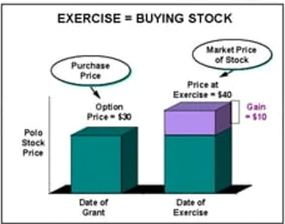
Financial terms we need to understand
Strike Price : Price at which owner of the option can buy or sell the underlying asset.
Volatility : degree of variation of trading price series over a time. (Magnitude of the fluctuation is unknown , volatility is used to measure of a certain financial assets. )

Slide 7
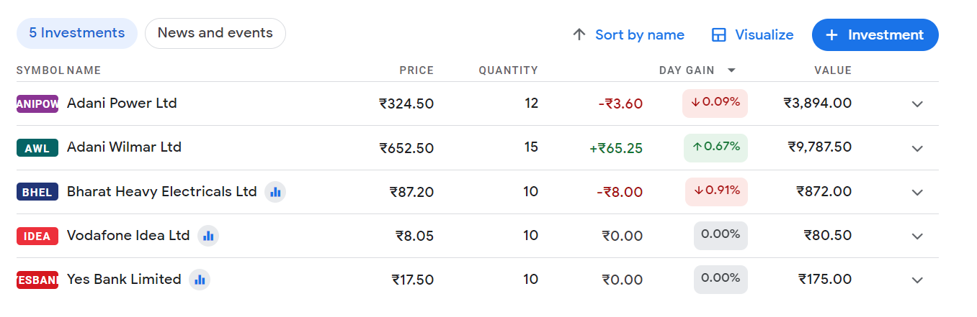
Financial terms we need to understand
Portfolio:
A group of financial assets such as stocks ,bonds and cash equivalents.
These are held directly by investor or managed by the financial professionals.

Slide 8


Financial terms we need to understand
Expiration Date : The date on which an option right or
warrant expires and becomes worthless if not exercised.
European option : An option which cannot be exercised
until the expiration date.
(b) American option : An option which can be exercised at
any time up to and including the expiration date.

Slide 9
Assumptions
These are assumptions that must be made to use the Black-Scholes equation.
1. The option can only be exercised at the expiration date, as it is a European option.
2. The direction of the stock's price can't be consistently predicted and is completely random.
3. Constant composition returns are normally distributed.
4. The future stock price at a given point of time must be lognormally distributed.
5. Volatility is known and constant.

Slide 10
Assumptions
6. These are efficient markets.
7. There are no dividends during the life of the option.
8. The risk-free rate is known and constant.
9. There are no taxes or transaction costs involved.
10. The returns on the risky asset are normally distributed.

Slide 11
Variables
• S= Stock price at the beginning of the time period of the option.
• K= Strike price, a price set between the buyer and seller of the option.
• T − t= Expiration date minus start date, the total amount of time until the option is exercised (in years).
• r= Risk-free interest rate.
• σ= Volatility of the stock.

Slide 12
Theorems that need to be understood before starting the Black Scholes Equation
Taylor’s Theorem
Ito’s Theorem

Slide 13
Taylor’s Theorem
It is used for the expansion of the infinite series such as sin x, log x etc. so that one can approximate the values of these functions or polynomials.

Slide 14
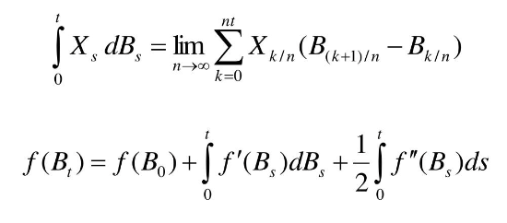
Ito’s Theorem
Ito's Lemma is a key component in the Ito Calculus, used to determine the derivative of a time-dependent function of a stochastic process.

Slide 15
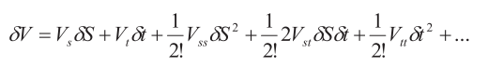
Explanation of Black Scholes Equation
Considering a general option value V(S,t). Therefore , from Talyor’s theorem we have the following expansion for V(S,t).
We substitute in its discrete form , that is
in the above equation , we get

Slide 16
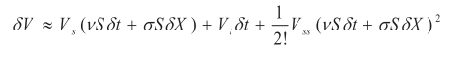
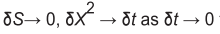
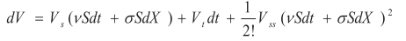
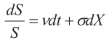
After , cancelling all insignificant terms in the last equation , we get
Therefore by taking the limits the above equation can be written in the following form :
By using the stochastic (unpredictable) differential equation and Ito’s lemma
We have

Slide 17
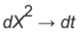
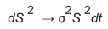
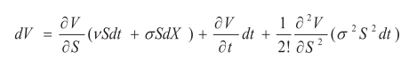
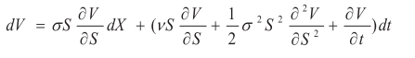
On rearranging the above terms we get
Therefore by applying the Ito’s lemma and assuming that as
then we get,

Slide 18
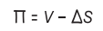
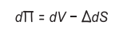
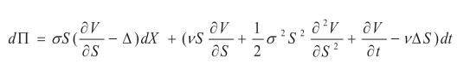
The value of portfolio ( ) is
The change in the portfolio is
On combining all the previous equations we get

Slide 19
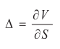
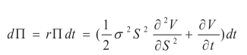
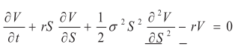
To eliminate the main contribution of randomness , we choose
On substituting the value into the previous equation we get
Finally after substituting the value of and dividing it by by dt , we get the equation.

Slide 20
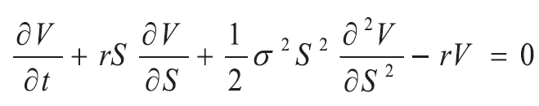

Slide 21
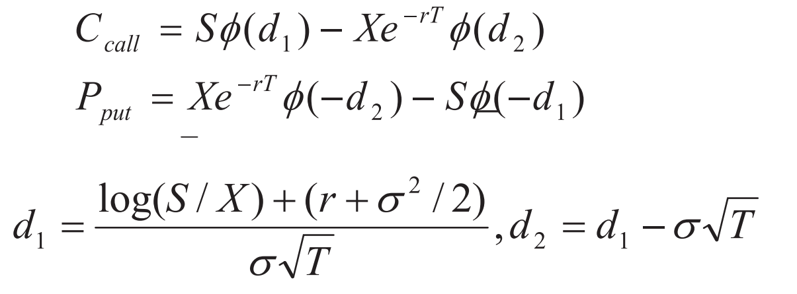
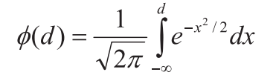
Black Scholes Option pricing Formula (Application)
ca

Slide 22
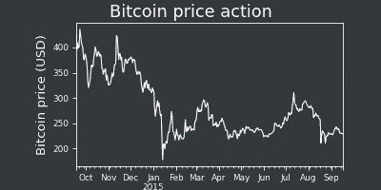
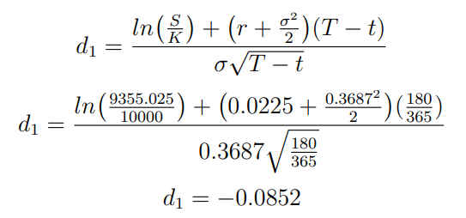
Lets consider an example
(Q) A stock we tracked was Bitcoin USD (BTC-USD). The starting stock price was
$9,355.025 and we set the strike price to $10,000. Over the time period of 180 days, the
volatility was 36.87% and an interest rate of 2.25%:
Sol:

Slide 23
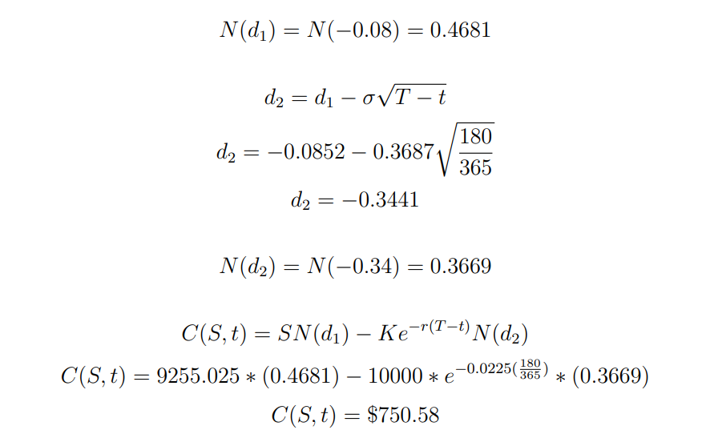
Since Bitcoin is a very volatile stock, the call price would be very large which connects to this example.

Slide 24
Disadvantages
Assumes constant values for the risk-free rate of return and volatility over the option duration. None of those will necessarily remain constant in the real world.
Assumes continuous and costless trading—ignoring the impact of liquidity risk and brokerage charges.
Assumes stock prices to follow a lognormal pattern, e.g., a random walk (or geometric Brownian motion pattern), thus ignoring large price swings that are observed more frequently in the real world.
Assumes no dividend payout—ignoring its impact on the change in valuations.
Assumes no early exercise (e.g., fits only European options). That makes the model unsuitable for American options.

Slide 25
Thank You

